Slide 1
K-Nearest Neighbor Algorithm
By
Shyamala Mathi

Slide 2
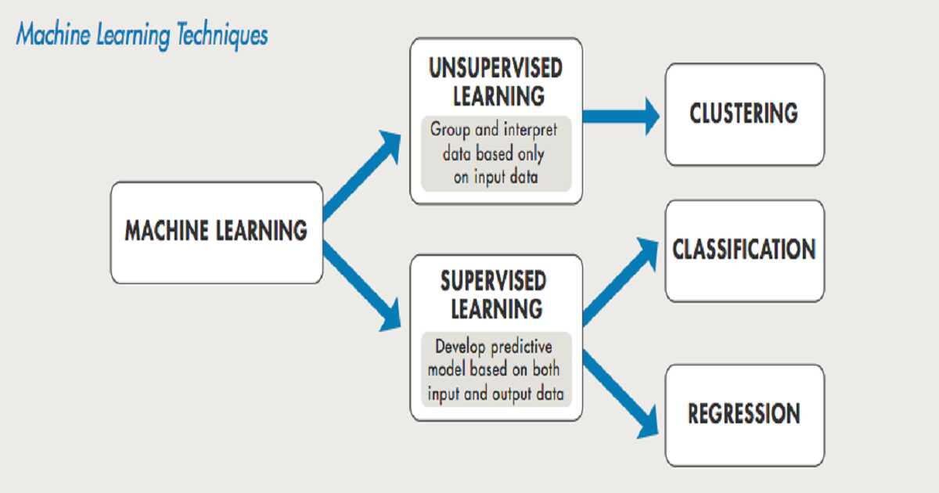

Slide 3
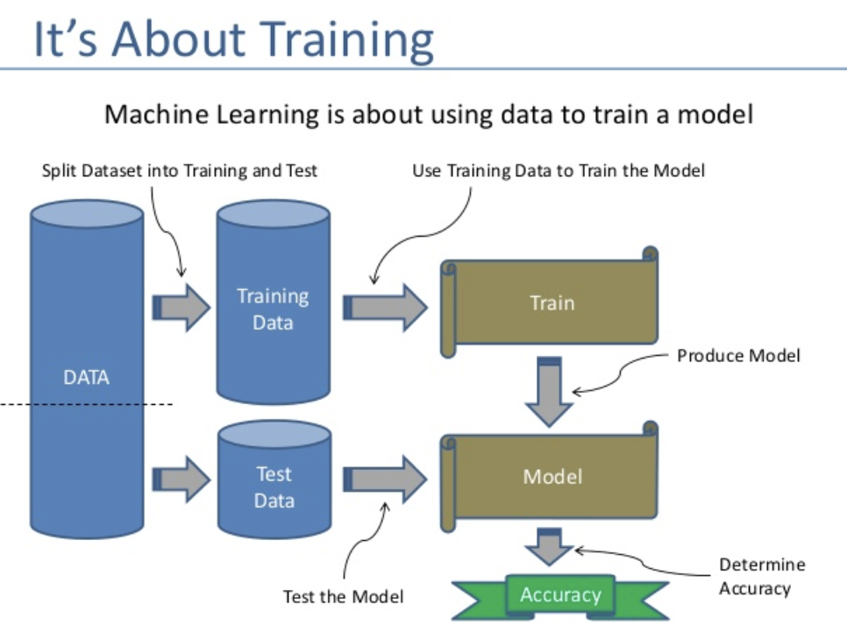

Slide 4
What is K-NN algorithm?
It is a supervised learning algorithm.
The KNN algorithm uses 'feature similarity' to predict the values of any new data points. This means that the new point is assigned a value based on how closely it resembles the points in the training set.

Slide 5
 | Features (I/P) | Labels (O/P)
Training | x1 | y1
 | x2 | y2
 | x3 | y3
 | x4 | y4
 | x5 | y5
 | x6 | y6
 | x7 | y7
Testing | X8 | y8
 | X9 | y9
 | X10 | Y10

Slide 6
K-NN Algorithm steps:
Load the data
Initialize K to your chosen number of neighbors
3.Calculate the distance of the new data point (for which we need to classify) from each of the data points present in the dataset.
4. Sort the data points from smallest to largest (in ascending order) depending upon their distances from the new point.
5. Pick the first K entries from the sorted collection
6. Get the labels of the selected K entries
7. If regression, return the mean of the K labels
8. If classification, return the mode of the K labels

Slide 7
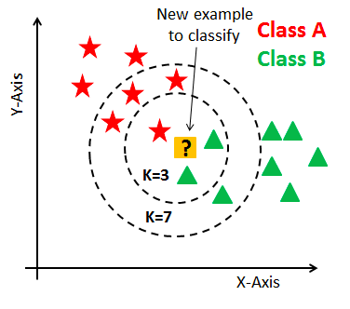
K-NN algorithm (graphically)

Slide 8
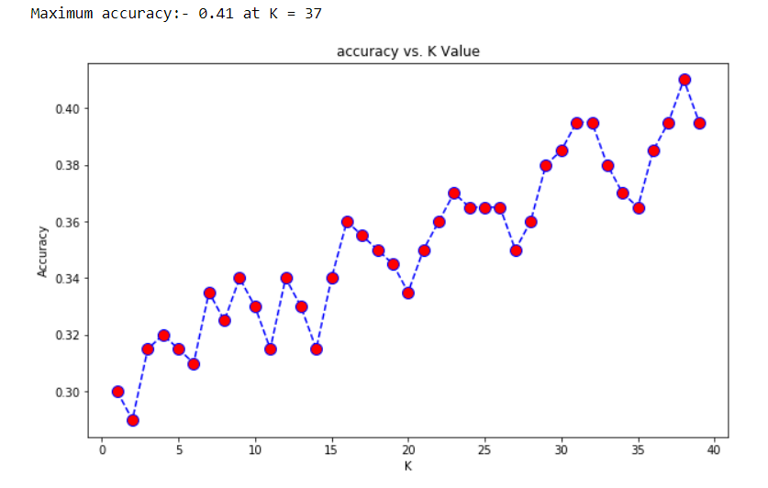
How to choose optimum K value?

Slide 9
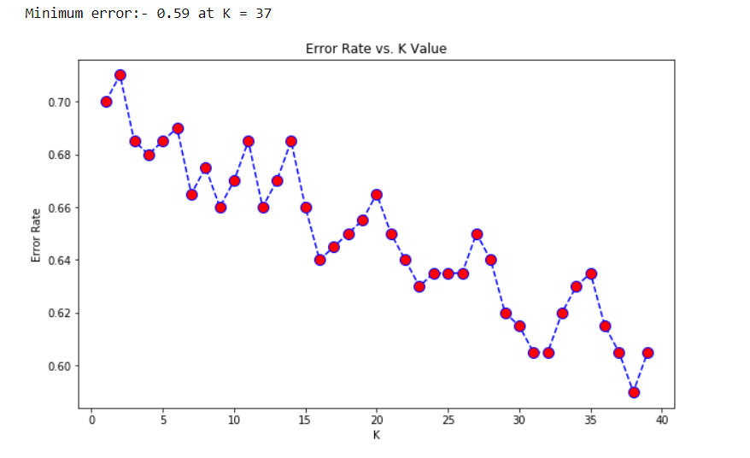
How to choose optimum K value?

Slide 10
Advantages of KNN
1. No Training Period: KNN is called Lazy Learner (Instance based learning). It does not learn anything in the training period. It does not derive any discriminative function from the training data. In other words, there is no training period for it. It stores the training dataset and learns from it only at the time of making real time predictions. This makes the KNN algorithm much faster than other algorithms that require training e.g. SVM, Linear Regression etc. 2. Since the KNN algorithm requires no training before making predictions, new data can be added seamlessly which will not impact the accuracy of the algorithm. 3. KNN is very easy to implement. There are only two parameters required to implement KNN i.e. the value of K and the distance function (e.g. Euclidean or Manhattan etc.)

Slide 11
Disadvantages of KNN
1. Does not work well with large dataset: In large datasets, the cost of calculating the distance between the new point and each existing points is huge which degrades the performance of the algorithm. 2. Does not work well with high dimensions: The KNN algorithm doesn't work well with high dimensional data because with large number of dimensions, it becomes difficult for the algorithm to calculate the distance in each dimension. 3. Need feature scaling: We need to do feature scaling (standardization and normalization) before applying KNN algorithm to any dataset. If we don't do so, KNN may generate wrong predictions. 4. Sensitive to noisy data, missing values and outliers: KNN is sensitive to noise in the dataset. We need to manually impute missing values and remove outliers.

